Slide 1

Design Patterns
Solutions to common problems in Software Design

Slide 2
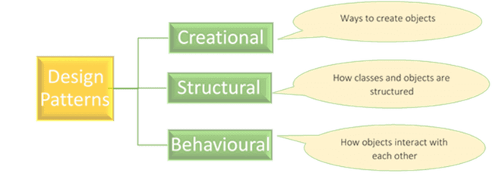
Types of Design Patterns

Slide 3
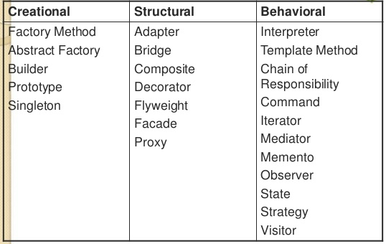
Clasification

Slide 4
Observer Pattern

Slide 5
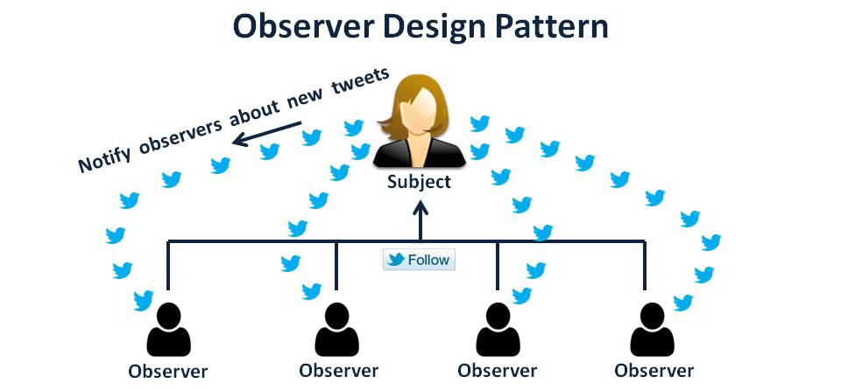
Observer Pattern
An object called subject maintains a list of its dependents called observers
Defines one to many dependency between objects so that one object change state, all of its dependents are notified and updated automatically.
The subject notifies its changes using a specific method defined in all of its dependents

Slide 6
Observer Pattern - Benefits
The subject (publisher) does not need to know anything about the Observers (suscribers)
Loose coupling
Subject only knows that observer implement Observer interface
There is no need to modify Subject to add or remove observers
The observer object does not need to be pending about any change, the subject is the responsible to notify that.
The push (notify) strategy is more efficient than the pull (ask all the time) one.
You have the posibility to add suscribers or remove suscribers whenever you want
This pattern is used in graphical interfaces, subscribing listeners to capture specific events
** Negative: The subject (Publisher) may send updates that do not matter to the Observer (suscriber)

Slide 7
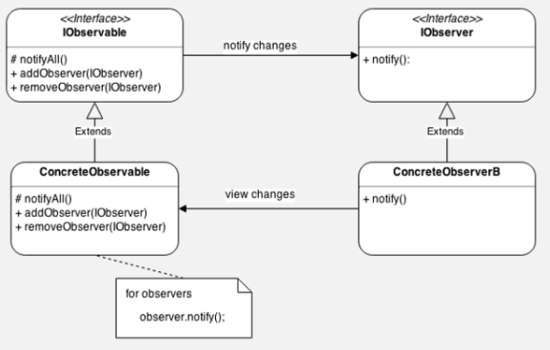
Observer Pattern – Class Diagram

Slide 8
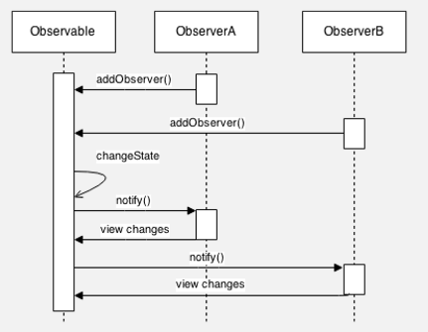
Observer Pattern – Diagram of Sequence

Slide 9
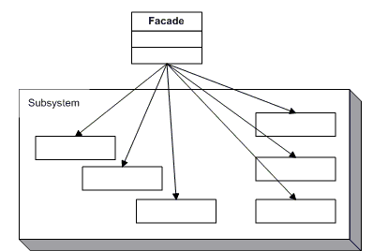
Facade Pattern
The façade pattern allows us to reduce the complexity of a system, by dividing it into subsystems, and additionally, it reduces the dependence of a client with respect to a certain component.
Ref: GOF Structural Patterns FACADE

Slide 10
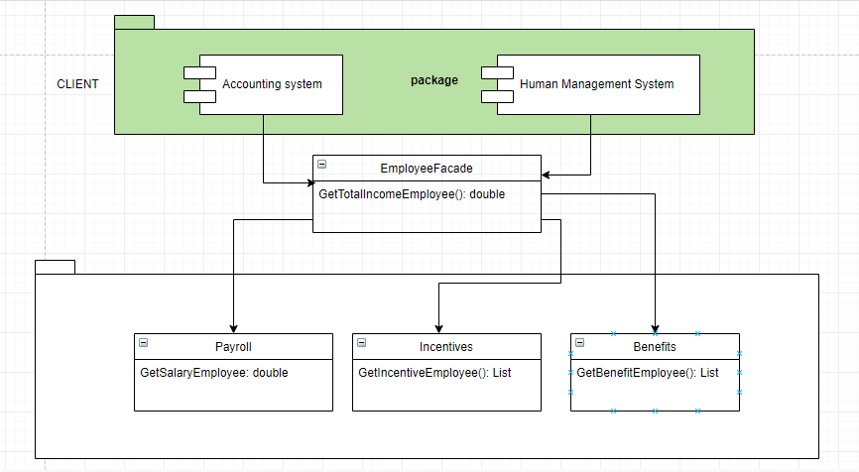
FACADE example
With facade

Slide 11
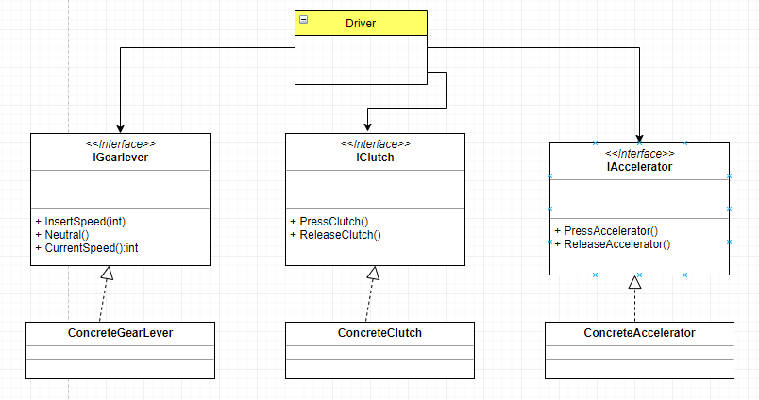
FACADE another example
Without facade

Slide 12
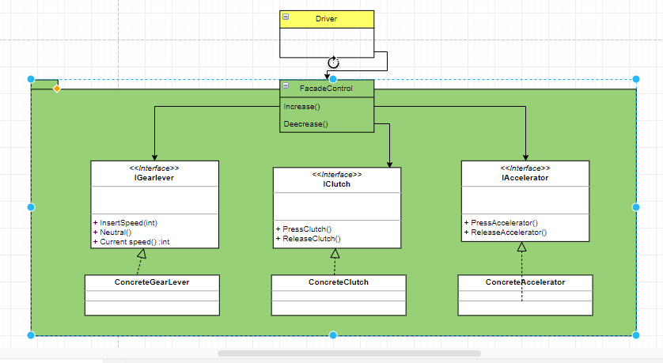
FACADE another example
With facade

Slide 13
Strategy Pattern

Slide 14
Strategy Pattern
This pattern can be used when you want to perform a function, but you might use different techniques.
Define a family of algorithms, encapsulate each one, and make them interchangeable.
Strategy lets the algorithm vary independently from clients that use it
Participants:
IStragegy: declares an interface common to all supported algorithms.
ConcreteStrategy: Implements the algorithm using the strategy interface
Context:
Is configured with a ConcreteStrategy object
Mainteins a reference to a Strategy object

Slide 15
Strategy Pattern - Benefits
Enables a client to choose wich algorithm to use from a family of algorithms and gives it a simple way to access it.
Behaviors are separate in specific clases that implement the general interface (IStrategy).
Allow better decoupling between the classs that uses a specific behavior
The behavior in the ConcreteStrategyClass can be changed without breaking the classes that use it
Use this patter whenever:
Many related classes differ only in their behaviour
A class defines many behaviors, and these appear as multiple conditional statements in its operations. Instead of many conditionals, move related conditional branches into their own strategy
An algorithm uses data that clients shouldn’t know about. Use this pattern to avoid exposing complex, algorithm-specific data structures.

Slide 16
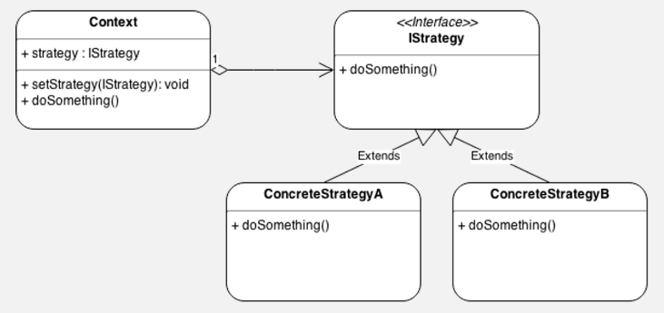
Strategy – Class Diagram

Slide 17
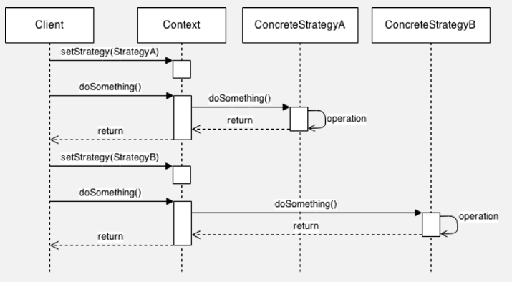
Strategy – Diagram of Sequence

Slide 18
Adapter Pattern

Slide 19

Adapter Pattern
The Adapter design pattern is used when we have incompatible software interfaces, which, despite their incompatibility, have similar functionality. This pattern is implemented when you want to homogenize the way you work with these incompatible interfaces, for which you create an intermediate class that works like an adapter. This adapter class will provide the methods to interact with the incompatible interface

Slide 20
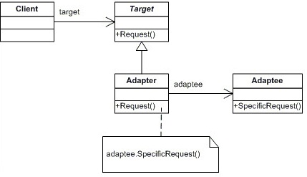
Adapter – Class Diagram

Slide 21
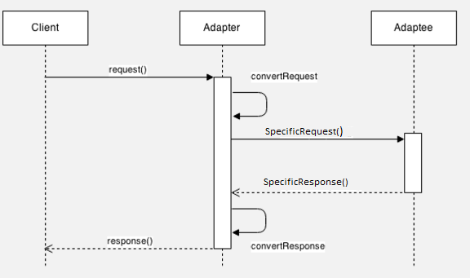
Adapter – Diagram of Sequence
The Client invokes the Adapter with generic parameters.
The Adapter converts the generic parameters into specific Adaptee parameters.
The Adapter invokes the Adaptee.
The Adaptee responds.
The Adapter converts the response of the Adaptee to a generic response for the Client.
The Adapter responds to the Client with a generic response.

Slide 22
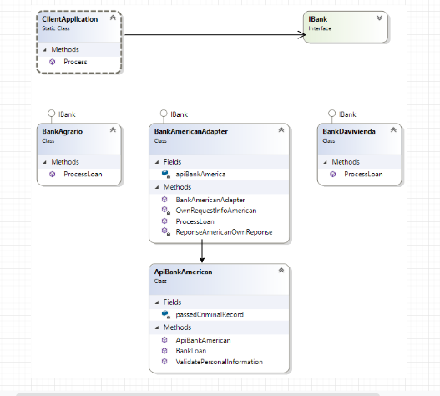
Adapter – Sample

